Slide 1
Introduction to Web Services

Slide 2
Objectives
After completing this lesson, you should be able to do the following:
Explain the need for web services
Define web services
Describe XML
List the different Java XML APIs
Create a web service
Create a web service client

Slide 3
Web Service: Definition
The World Wide Web Consortium (W3C) defines a web service as follows:
“A web service is a software system designed to support interoperable machine-to-machine interaction over a network. It has an interface described in a machine-processable format (specifically WSDL). Other systems interact with the web service in a manner prescribed by its description using SOAP messages, typically conveyed using HTTP with an XML serialization in conjunction with other web-related standards.”
Note: Over the years, web services have evolved beyond this definition.

Slide 4
Characteristics of Web Services
Platform neutral (both CPU architecture and programming language independent)
A platform-neutral data-interchange format is needed (text instead of binary).
Client-server architecture
A server has a set of available operations.
A client can request the execution of an operation on a server.
“Web” services are most likely to use HTTP as a transport protocol.
In theory, SOAP services are not tied to HTTP. In practice, you almost always use HTTP.
Notes:
Reasons why HTTP works well for a remote method invocation protocol include:
HTTP libraries and utilities are available for every language and platform.
Hardware support: HTTP and TCP/IP are supported by all modern networking equipment.
Security Policies: Corporate routers often block all but the most common types of network traffic. By using common ports and protocols, network traffic is likely to be allowed to flow across corporate networks. Some issues may arise when a web service uses all the features of HTTP, unlike normal web browsing traffic, which is typically limited to HEAD, GET, and POST operations.

Slide 5
Service Descriptions
Web service clients are coded to call operations present on a remote server. The available operations must be discovered in order for the client to call them.
Web Services Description Language (WSDL): Similar to a Java interface. A list of all operations, parameters, and return types.
Primarily for SOAP services

Slide 6
XML in Web Services
To facilitate a platform-neutral exchange of data, a general purpose data-interchange format is needed.
Extensible Markup Language (XML): Used by SOAP services
A large number of processing libraries exist to support XML in almost every language.
Java developers can use SAX, DOM, JAXB.
SOAP web service rely on XML but libraries hide a large portion of the XML work.

Slide 7
Approaches to Developing Web Services
There are two main types of web services:
SOAP: Heavily standards based, evolved over the years
XML data is transmitted across HTTP using a POST request.
The XML data lists the method and parameters to call.
An XML response is generated containing the method return data.
It is closely tied to formal interface definitions (WSDL).
WSDL > Code (top-down development)
Code > WSDL (bottom-up development)
REST: Lightweight, less formal approach
Uses HTTP operations as method names (GET, POST, and so on)
Different URLs for different “resources” (similar to objects)
Parameters and return data in either XML or JSON

Slide 8
Web Services Implementations
SOAP web services are supported by JAX-WS.
JAX-WS is part of Java SE, but a production-grade HTTP server is not.
The Metro project is a popular “complete” JAX-WS implementation that is a GlassFish project.
WebLogic Web Services Stack is now based on Metro.

Slide 9
Web Services Within Java EE Containers
Web services rely on HTTP communication and therefore need production-grade HTTP connection handling—a web container.
Tomcat, GlassFish, and WebLogic are all examples of web containers.
Metro can be added to a basic web container like Tomcat.
Web services simply provide a platform-neutral wrapper around business logic.
If your logic needs transactions, security, or any of the other features provided by a Java EE application server, then you will most likely end up creating web service classes, which delegate to EJBs that use JPA.

Slide 10
Web Service Tools
Web service testing tools are commonly used during the development of web services, primarily as general-purpose clients.
Application servers may have integrated testing tools—GlassFish and WebLogic have web applications that generate forms to call SOAP operations.
Command-line clients like cURL are great for testing and also allow shell scripts to function as web service clients.
Because web browsers have extensive support for HTTP, they can not only function a basic testing tools but also commonly have extensions that provide greater HTTP control to the end user.
Notes:
You often develop both a web service client and the web service itself. In early development stages, when things do not work, it may be difficult to determine where the fault is. General-purpose clients help eliminate one side of the equation as a source of the problem.
Many more web service testing tools are available than covered in this course. IDEs may contain testing tools or they may have available plug-ins. Stand-alone testing tools like SoapUI are also available.

Slide 11



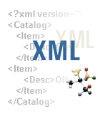

Extensible Markup Language
Extensible Markup Language (XML) describes data objects called XML documents that are composed of markup and data.
Web data
Markup and data
XML document
Custom tags
XML processors
Notes:
XML describes data objects called XML documents that:
Are composed of markup language for structuring the document data
Support custom tags for data definition, transmission, validation, and interpretation
Have become a standard way to describe data on the web
Are processed by XML processors
XML was developed by an XML working group headed by the World Wide Web Consortium (W3C) with the following design goals:
XML is usable over the Internet.
It supports a wide variety of applications.
It is compatible with Standard Generalized Markup Language (SGML).
XML can be processed using easy-to-write programs.
It has a minimum number of optional features.
XML is human-legible and reasonably clear.
XML enables quick design preparation.
It enables formal and concise design.
XML documents are easy to create.
XML documents can be verbose.

Slide 12
Advantages of Using XML
XML enables:
A simple and extensible way to describe data
The ability to interchange data
Simplified business-to-business communication
Writing of smart agents
The ability to perform smart searches
Sample XML document:
<?xml version="1.0"?>
<books>
<title>Building Oracle XML Applications</title>
<title>Oracle XML Handbook</title>
<title>Beginning XML Second Edition</title>
</books>
Notes:
XML’s strongest point is its ability to perform data interchange. Because different groups of people rarely standardize on a single set of tools, it takes a significant amount of work for two groups to communicate. XML makes it easy to send structured data across the web so that nothing gets lost in translation.
When using XML, you can receive XML-tagged data from your system, and you can receive XML-tagged data from another system. Neither of the users has to know how the other user’s system is organized. If another partner or supplier teams up with your organization, you do not have to write code to exchange data with their system. You simply require them to follow the document rules defined in the document type definition (DTD). You can also transform those documents using XSLT.
When writing an agent, one of the challenges is to make sense of incoming data. A good agent interprets information intelligently, and then responds to it accordingly. If the data sent to an agent is structured with XML, it is much easier for the agent to understand exactly what the data means and how it relates to other pieces of data it may already know.
The slide shows a simple example of an XML document containing a list of book titles. The XML document can be embellished or restructured depending on how it will be used.

Slide 13
Importance of XML in Web Services
Web services standards such as SOAP, WSDL are XML based.
Service Description:
Web Services Description Language (WSDL)
Messaging:
SOAP
Representation:
XML is the universal representation language.
Notes:
Many businesses today are becoming e-businesses. The greatest barrier to this transformation is application-to-application communication. An enterprise system usually has multiple applications, each running on different hardware and sometimes implemented in different languages. These applications often need to exchange data with one another, and developers must write additional code to make this integration possible. A web service is a technology (based on a set of standards) that provides a solution for application-to-application communication and enterprise application integration.
Using web services, clients and servers can communicate over standard Internet protocols regardless of the platform or programming language. Developers can write their business functionality in any language and on any platform.
To be exposed and accessed as web services, the applications must be developed according to the standards used by web services. Web services standards use the core concept of XML-based representation to carry out information exchange between service providers and requestors.
Simple Object Access Protocol (SOAP) is a lightweight, XML-based protocol for exchanging data in a distributed environment. The definition of SOAP is in XML and places no restriction on the format.

Slide 14
XML Elements
An XML element has a start tag, an end tag, and optional data content.
Tag names are case-sensitive (must be identical).
Empty elements:
Contain no data
May appear as a single tag
Tag name
<employee>
Start tag
Data content
Element
<name>Steven King</name>
</employee>
End tag
Tag name
<initials></initials>
<initials/>
Notes:
A start tag (for example, <employee>) includes:
The “<” character
A case-sensitive tag name (employee), without leading spaces
The “>” character
An end tag (for example </employee>) includes:
The “<” character
A case-sensitive tag name that must be identical to the start tag name, but prefixed with a slash. Leading spaces are not permitted.
The “>” character
Data content: Can also contain elements such as <name> in the slide example
In summary, an XML element includes a start tag, an end tag, and everything in between.
Empty elements have no content between the start and end tags. In this case, a shortened form can be used where the start tag name is followed by a slash (for example, <initials/>).
Tag names are descriptive terms for an XML element and its content (for example, employee). The tag name is known as the element type name.

Slide 15
Markup Rules for Elements
There is one root element, which is sometimes called the top-level or document element.
All elements:
Must have matching start and end tags, or be a self-closing tag (an empty element)
Can contain nested elements so that their tags do not overlap
Have case-sensitive tag names that are subject to naming conventions (starting with a letter, no spaces, and not starting with the letters xml)
May contain white space (spaces, tabs, new lines, and combinations of them) that is considered part of the element data content
Notes:
Every XML document must contain one root element (top-level or document element). XML documents are hierarchical in structure with elements nested within others forming a document tree. The start and end tags for elements must not overlap, for example: <employee>
<first_name>Steven<last_name>king</first_name></last_name>
</employee>
Here, the <last_name> element overlaps the <first_name> element. This is not permissible. The correct form is:
<employee> <first_name>Steven</first_name><last_name>king</last_name>
</employee>
Element start and end tag names must be identical; that is, they are case-sensitive. For example, <Employee>, <employee>, and <EMPLOYEE> are distinct and different tag names.
Element tag names must start with a letter or an underscore (_) but not with numeric or punctuation characters. Numeric, dash (-), and period (.) characters are allowed after the first letter, but not white space. Tag names cannot start with the xml letter sequence or any case-sensitive combination thereof, such as XML and Xml. White space, including new lines, are considered part of the data; that is, no stripping of white space is done.

Slide 16
Naming Convention Rules for Elements and Attributes
Element and attribute names:
Can contain letters A–Z and a–z
Can contain numbers 0–9
Can contain an _ (underscore), - (dash), and . (period)
Must start with letters or an “_”
Cannot start with a number, punctuation character, or the letters xml (or XML, Xml, and so on)
Cannot contain spaces
Can use any name; no words are reserved
Notes:
Note: An ideogram (from Greek “idea” + “to write”) is a graphic symbol that represents an idea or concept. Examples of ideograms include wayfinding signs, such as in airports and other environments, where people may not be familiar with the language of the place they are in. Ideograms are used worldwide regardless of how they are pronounced in different languages.

Slide 17
XML Namespaces
To successfully combine XML vocabularies with no confusion there must be a way to uniquely identify each element.
Java classes like Person are placed in packages.
Java packages are used to create namespaces.
XML did not originally support namespaces.
XML Namespaces became a W3C recommendation in 1999.
URIs are assigned to XML components to uniquely qualify them. The concept can be show like so: <{http://example.com/vocab1}person>
URIs can contain characters that are not allowed in element names. Aliases (known as prefixes) to URIs are used: <exvocab:person>
Notes:
When using XML namespaces the part of the tag name that follows the colon (person in the example above) is known as the local name. The <prefix:local> form creates a qualified name or QName.

Slide 18
Using XML Namespaces
The xmlns:prefix="URI" attribute is used to create a namespace declaration.
<exvocab:person xmlns:exvocab="http://example.com/vocab1">
</exvocab:person>
A namespace declaration may appear on the starting tag where the prefix is used or on an enclosing (ancestor) element.
It is common to declare multiple namespaces at the root element of a document.
A default namespace may be declared with no prefix.
<person xmlns="http://example.com/vocab1">
</person>
Notes:
Namespace prefixes and the default namespace can be redefined multiple times throughout an XML document but you should avoid doing this as it can lead to confusing to the human readers of your documents. Best practice is to place all your namespace declarations at the top of your documents.

Slide 19
XML Schema Document: Example
A simple XML Schema uses:
A required XML Namespace string, with an xs prefix, http://www.w3.org/2001/XMLSchema
The <schema> element as its document root
The <element> element to declare an element
A valid XML instance document:
<?xml version="1.0"?>
<xs:schema xmlns:xs="http://www.w3.org/2001/XMLSchema">
<xs:element name="departments" type="xs:string"/>
</xs:schema>
XSD
<?xml version="1.0"?>
<!-- The element cannot contain child elements -->
<departments>
Finance
</departments>
XML
Notes:
The example in the slide shows a simple XML Schema document that declares a single element called departments. The XML Schema Document (XSD) uses the required XML Namespace value http://www.w3.org/2001/XMLSchema, which is assigned the xs namespace prefix. The xs prefix is used to qualify the schema, element, and string names to ensure that the XSD document structure conforms to the W3C XML Schema language recommendation; that is, the XSD itself is a valid document.
The XML Schema language elements used in the example are:
The <xs:schema> element, which is the root element for the XSD, and contains the definitions for the structure of the XML instance document
The <xs:element> element, which declares a root element name, departments, for the XML instance document, an example of which is shown below the XSD code
The <xs:string> value, which is set as the data type for the contents of the departments element in the XML instance document. In this case, the data can be any string but not markup; that is, no child elements are permitted.
Although the example is a very simple XML Schema document, the resulting XML instance document structure that can be created is not very useful.
Note: Using a namespace prefix, such as xs or xsd, is recommended but not required.

Slide 20
Java XML APIs
There are several ways to process XML in Java.
Java API for XML Processing (JAXP):
SAX – An event-based parser framework. Developers create event handlers that fire when reading a document.
DOM – An object model. An XML document is converted into a tree of objects comprised of types such as org.w3c.dom.Element.
Java Architecture for XML Binding (JAXB): Binds an XML document to a tree of objects similar to DOM. Unlike DOM, the object types are custom types.
Notes:
Both SAX and DOM processing models are low level and can result in very verbose code. If you want to read XML documents and cannot use JAXB (because the XML syntax is not known at compile time), then using StAX should be your first consideration.
SAX (a streaming push parser model) is extremely fast and has a low memory footprint, but is probably the most challenging method to process XML in Java.
DOM provides an object tree in memory and is easier to program against than SAX, but consumes more memory.
StAX (a streaming pull parser model) is different than SAX in that instead of having the parser fire events, you request the next event by calling next().

Slide 21
JAXB: Overview
Allows reading and writing of XML documents
Is an object-based model of XML document structure similar to DOM
Binds developer-supplied object types to XML with no need to read XML into memory and then insert the data into domain objects
Is an annotation-based configuration of Java to XML mapping
Supports XML Schema to Java class generation and Java class to XML Schema generation
Is used by JAX-WS and JAX-RS
Return values and method parameters that are JAXB-annotated class types are automatically converted for you.

Slide 22
XML and Java Class Comparison
Given the following XML document:
<?xml version="1.0" encoding="UTF-8"?>
<person>
<name>Matt</name>
</person>
An equivalent Java class is:
@XmlRootElement
public class Person {
private String name;
public String getName() {/*…*/}
public void setName(String name) {/*…*/}
}

Slide 23
Reading XML with JAXB
Reading XML is accomplished by using a JAXBContext, one or more JAXB annotated classes, and an Unmarshaller.
try {
JAXBContext jc =
JAXBContext.newInstance(Person.class);
Unmarshaller u = jc.createUnmarshaller();
InputStream in =
new FileInputStream("src/simple-read.xml");
Person p = (Person)u.unmarshal(in);
System.out.println("Name: " + p.getName());
} catch (JAXBException | IOException ex) {
ex.printStackTrace();
}

Slide 24
Writing XML with JAXB
Writing XML is accomplished by using a JAXBContext, one or more JAXB annotated classes, and a Marshaller.
try {
Person p = new Person();
p.setName("tom");
JAXBContext jc =
JAXBContext.newInstance(Person.class);
Marshaller m = jc.createMarshaller();
OutputStream out =
new FileOutputStream("src/simple-write.xml");
m.marshal(p, out);
} catch (JAXBException | IOException ex) {
ex.printStackTrace(); }

Slide 25
xjc
xjc is the JAXB Binding Compiler. xjc takes XML Schema input and produces a Java package containing Java classes.
xjc -p ou.xjc person.xsd
Produces:
Factory methods JAXB bound classes
ou/
xjc/
ObjectFactory.java
package-info.java
Person.java
Java Package
A place for annotations that apply to all classes in a package
A Java class for each complex type
Notes:
person.xsd XML Schema
<xs:schema version="1.0" xmlns:xs="http://www.w3.org/2001/XMLSchema"
elementFormDefault="qualified" targetNamespace="urn:example">
<xs:element name="person">
<xs:complexType>
<xs:sequence>
<xs:element name="name" type="xs:string"/>
</xs:sequence>
</xs:complexType>
</xs:element>
</xs:schema>

Slide 26
schemagen
schemagen is the JAXB Java to XML Schema generator. schemagen takes one or more Java files as input and produces XML Schemas.
schemagen ou\simple\Person.java
Produces schema1.xsd and ou\simple\Person.class
Notes:
JAXB does not require an XML Schema file for reading or writing unless you want to perform validation.

Slide 27
JAXBContext
The JAXBContext class is the entry point into the JAXB API. It is used to obtain:
An Unmarshaller that can read XML
A Marshaller that can write XML
JAXBContext can be passed a var-args class listing.
JAXBContext jc = JAXBContext.newInstance(Person.class);
JAXBContext can be passed a string of packages names.
JAXBContext jc = JAXBContext.newInstance("ou.schema");
Notes:
When supplying a string of package names:
Multiple package names can be supplied by separating the package names with colons.
JAXBContext jc = JAXBContext.newInstance("ou.schema:ou.other");
Every package specified must contain either:
An ObjectFactory.java that is annotated with @XmlRegistry and contains a factory method for each Java class bound to an XML type.
A jaxb.index file. The jaxb.index file contains a list of JAXB bound class names (short name without package), one class name per line.
Did you know you can switch JAXB implementations? EclipseLink Moxy is one available JAXB implementation. Moxy has additional features such as support for external binding files and JSON reading and writing. When you create a new JAXBContext instance, several checks are made to see if you have configured an alternate JAXB implementation. For more information, see the section titled Discovery of JAXB Implementation on http://docs.oracle.com/javase/7/docs/api/javax/xml/bind/JAXBContext.html and http://www.eclipse.org/eclipselink/moxy.php.

Slide 28
Errors and Validation
JAXB does not perform strict validation checking by default.
When reading XML, unexpected elements and attributes that are not mapped to Java elements are ignored.
When reading XML, malformed XML will cause a javax.xml.bind.UnmarshalException when calling unmarshall.
If you want to keep track of validation failures, you can attach a ValidationEventHandler to the Unmarshaller.
Unmarshaller u = jc.createUnmarshaller();
ValidationEventCollector vec =
new ValidationEventCollector();
u.setEventHandler(vec);
Notes:
When unmarshall is called, any validation events will result in a call to the attached ValidationEventHandler. The ValidationEventCollector implementation of ValidationEvenHandler simply collects the events so they can be reviewed at a later time.
if(vec.hasEvents()) {
for(ValidationEvent e : vec.getEvents()) {
System.out.println("Event: " + e);
}
}

Slide 29
XmlRootElement
The @XmlRootElement annotation is used to indicate that a class is used as a global (root) XML element.
@XmlRootElement(name="human")
public class Person { /* … */
Corresponds to an XML Schema of:
<xs:element name="human" type="person"/>
<xs:complexType name="person">
<!-- ... -->
</xs:complexType>

Slide 30
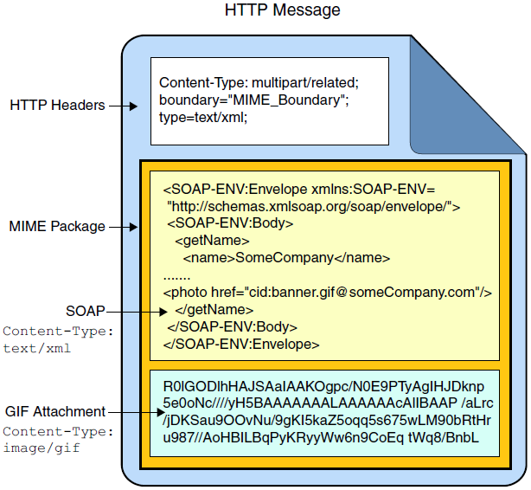
SOAP Over HTTP

Slide 31
Reasons for Using SOAP
The SOAP web services specification sets out to define an interoperable, platform-independent means for component interaction. SOAP web service requirements include:
Decouple message representation from transport mechanisms
Support extensible frameworks
Notes:
SOAP was originally an acronym for Simple Object Access Protocol. In SOAP 1.2 the term SOAP is no longer an acronym. This course primarily uses SOAP 1.1.

Slide 32
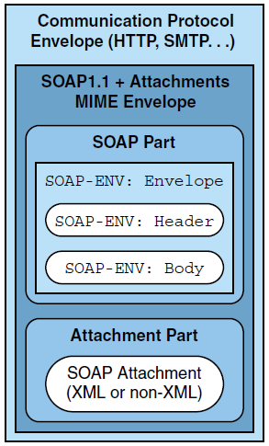
Extensible Message Representation Simple Object Access Protocol

Slide 33
SOAP
SOAP is acronym for Simple Object Access Protocol
SOAP is a communication protocol
SOAP provides data transport for Web services
SOAP can exchange complete documents or call a remote procedure
SOAP can be used for broadcasting a message
SOAP is platform and language independent
SOAP is the XML way of defining what information gets sent and how

Slide 34
SOAP Building Blocks
A SOAP message is an ordinary XML document containing the following elements:
An Envelope element that identifies the XML document as a SOAP message
A Header element that contains header information
A Body element that contains call and response information
A Fault element containing errors and status information

Slide 35
SOAP Request
<?xml version="1.0" encoding="UTF-8"?>
<S:Envelope xmlns:S="http://schemas.xmlsoap.org/soap/envelope/">
<S:Header/>
<S:Body>
<ns2:hello xmlns:ns2="http://service/">
<name>a</name>
</ns2:hello>
</S:Body>
</S:Envelope>

Slide 36
SOAP Response
<?xml version="1.0" encoding="UTF-8"?>
<S:Envelope xmlns:S="http://schemas.xmlsoap.org/soap/envelope/">
<S:Body>
<ns2:helloResponse xmlns:ns2="http://service/">
<return>Hello a !</return>
</ns2:helloResponse>
</S:Body>
</S:Envelope>

Slide 37
WSDL
WSDL stands for Web Services Description Language
WSDL is written in XML
WSDL is an XML document
WSDL is used to describe Web services
WSDL is also used to locate Web services
WSDL is a W3C recommendation

Slide 38
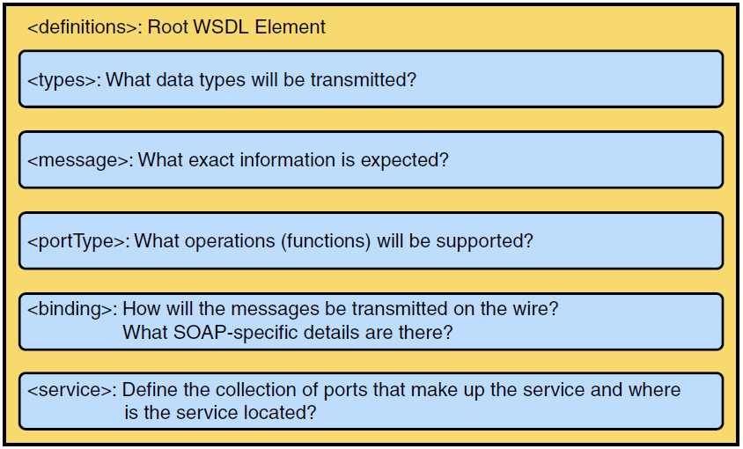
Structure of a WSDL File

Slide 39
WSDL Elements
Definition: element must be the root element of all WSDL documents. It defines the name of the web service, declares multiple namespaces used throughout the remainder of the document, and contains all the service elements described here.
Data types: the data types - in the form of XML schemas or possibly some other mechanism - to be used in the messages
Message: an abstract definition of the data, in the form of a message presented either as an entire document or as arguments to be mapped to a method invocation.
Operation: the abstract definition of the operation for a message, such as naming a method, message queue, or business process, that will accept and process the message

Slide 40
Port type : an abstract set of operations mapped to one or more end points, defining the collection of operations for a binding; the collection of operations, because it is abstract, can be mapped to multiple transports through various bindings.
Binding: the concrete protocol and data formats for the operations and messages defined for a particular port type.
Port: a combination of a binding and a network address, providing the target address of the service communication.
Service: a collection of related end points encompassing the service definitions in the file; the services map the binding to the port and include any extensibility definitions.

Slide 41
Bottom-Up Approach
When you provide a web service interface to an existing enterprise application, you should work from Java code:
You can use the quickest development path.
It is a natural approach, especially when business logic has already been implemented.
You can map existing domain models directly to WSDL with little effort.
You can re-use a service facade as a mediator to the domain logic for other types of applications and clients.

Slide 42
Starting from a Java Class
You develop
@WebService SEI Interface_
POJO Implementation Class
Servlet-based or Stateless Session EJB
Optional handler classes
War or ear
Packaged application (war/ear file)
Deployment
Create JAXB and JAX-WS files needed for the service
WSDL Service Contract

Slide 43
JAX-WS: Java to WSDL
WSDL
types
portType
JAXB
Service Endpoint
Implementation (SEI)
JAX-WS
operation
+ method (…)

Slide 44
JAX-WS: SOAP to Java
SOAP
Java
<env:Envelope..>
<env:Head.../>
<env:Body…>
<submitOrder>
<order…>
<date>20080507</date>
<itemNum>DW0-88</itemNum>
…
</order>
</submitOrder>
</env.Body>
<env:Envelope>
@WebService
public class OrderManager{
…}
public void submitOrder(Order ord){
…}
}
OrderManager
JAX-WS
JAXB
Order

Slide 45
JAX-WS Requirements: Requirements on the Java Class
Must be annotated with javax.ws.WebService
Must not be declared final
Must not be abstract
Must have a default public no-arg constructor
Must not have a finalize method

Slide 46
JAX-WS Requirements: Requirements on Web Service Methods
Must be public By default, every public method in the class will be part of the web service.
Methods can be excluded as web service methods using @WebMethod(exclude=true).
Must not be static or final
Must have JAXB-compatible parameters and return types
Parameters and return types must not implement the java.rmi.Remote interface.
Notes:
Previous to JAX-WS tooling version 2.1.6, methods without @WebMethod would only be exposed as operations if no other methods were annotated with @WebMethod.

Slide 47
Web Service Errors
Web Services can experience errors in two places:
On the server
In your web service an exception is thrown. How you convey that to a client depends on the type of web service (SOAP or REST)
On the client
Clients receive the errors produced by a web service.
Clients experience error without there being any error produced by a server (networking problems, for example).

Slide 48
SOAP Faults
The equivalent of an exception in a SOAP web service is called a "fault."
Application faults must be listed in the service's WSDL.
Similar to methods declaring they throw a checked exception
Known as modeled exceptions
Mapped to custom classes
Faults can occur without being in the WSDL.
Similar to runtime exceptions, things that shouldn't happen
Known as unmodeled exceptions
Uses javax.xml.ws.soap.SOAPFaultException

Slide 49


